Slide 1
Citation screening using Deep Learning
Course : 7151CEM - Computing Individual Research Project
Project Supervisor : Professor Dr. Xiaorui Jiang
Student Name : Mohnish Chaudhary
Student Id : 11909183

Slide 2
Introduction
A systematic review summarizes the medical literature by synthesizing the findings of several primary studies that are related to one another, using explicit and reproducible procedures to search for and critically evaluate the findings.
A concise systematic review is required because a primary healthcare professional cannot read an inconceivable number of articles every day.
Citation-screening is a crucial stage in the systematic review process in which search results from numerous databases are assessed using strict inclusion and exclusion criteria by reviewing a record's title and abstract to filter out irrelevant entries and highlight those for which the full-text document should be requested for further screening

Slide 3
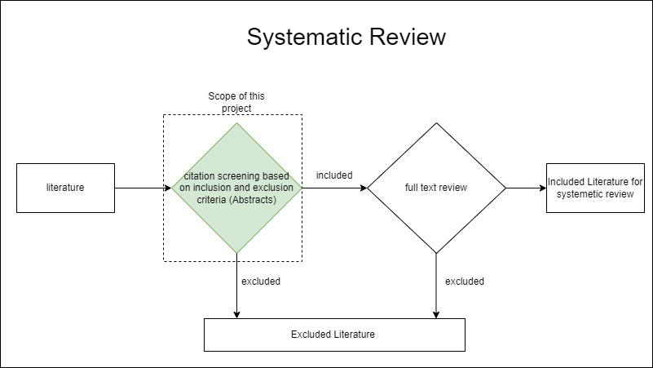
Systematic review Process
challenge
Citation-screening is a very time-consuming process, and it requires a lot of human resources. To further support the argument there are over 13 million references and over 4800 biomedical and health publications in Medline alone, its not possible for a primary healthcare professional go through the entire literature.
Objective
The goal of this project is to reduce the time and effort required for citation screening by automating filtering of citations by a deep learning-based model

Slide 4
Relevant Existing Studies
Deep learning-based studies
Kontonatsios et al., 2020, tried a denoising autoencoder with the feedforward network and SVM (Support vector machines)
van Dinter et al., 2021, tried a Multi-Channel Convolutional Neural Network.
Classical Machine learning based study
(Howard et al., 2016) experimented with SVM and logistic regression using various features such as TFIDF, latent Dirichlet allocation (LDA), and singular value decomposition (SVD), approaching citation screening as a binary classification problem
Limitations:
Because most of the data sets in these studies are very small, Above studies do not use pretrained models that already have domain specific knowledge that can provide complementary information. Pre-trained models, such as BioLinkBERT can be helpful.
Transformer-based models now outperform SOTA in almost all NLP tasks. A transformer-based model could be useful.

Slide 5
Dataset
In this study we have used 23 dataset of systematic studies as used in . (Kusa et al., 2022) which are publicly available.
Characteristics :
Dataset categories : Drug (15), Clinical(3) and SWIFT(5)
Datasets ranging from 327 to 48638 datapoints
Fraction of included citations 9(0.5%) to 136(27%)
Challenges :
Highly imbalanced datasets
Very less data to train deep learning models

Slide 6
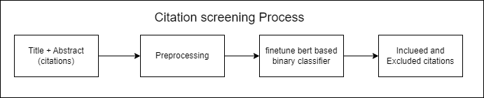
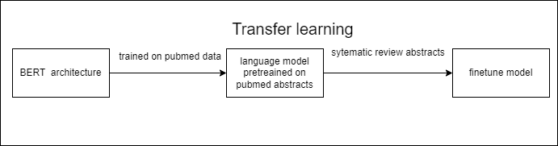
Solution
To develop a transformers based deep learning solution to automate the process of citation screening. In this solution we will define citation screening as a binary classification problem.
Finetuning model

Slide 7
Experiments
Leverage the models pretrained on PubMed abstracts and finetune for the task of citation screening . Utilizing transfer learning approach to provide complementary knowledge to the models.
Models used – BioLinkBERT, PubMedBERT etc.
Augmentation of the dataset for included citations(+ve class) by transferring the abstracts from English to German and then back to English.
Leveraging the sentences with PICOs(patient/population, intervention, comparison and outcomes) to filter out noise from the abstracts and train a model.
Model | BLURB Score | PubMedQA | BIOASQ | MedQA-USMLE
BioLinkBERT-base | 83.39 | 70.2 | 91.4 | 40.0
BioLinkBERT-large | 84.30 | 72.2 | 94.8 | 44.6
PUbMedBERT | 82.75 | 55.84

Slide 8
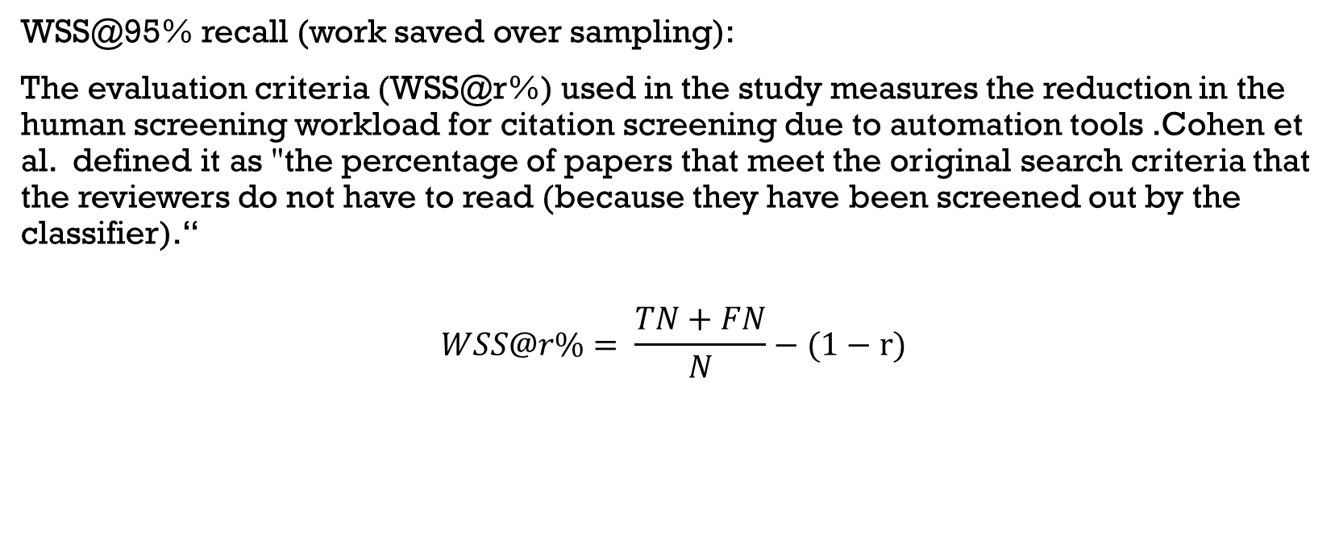
Evaluation criteria
WSS@95% recall (work saved over sampling):
The evaluation criteria (WSS@r%) used in the study measures the reduction in the human screening workload for citation screening due to automation tools .Cohen et al. defined it as "the percentage of papers that meet the original search criteria that the reviewers do not have to read (because they have been screened out by the classifier).“
$$WSS@r\%= \frac{TN+FN}{N}−(1−r)$$

Slide 9
RESULTS
Our results are between the results of the previous 2 deep learning studies
Because of the small dataset size and to have the exact same process of training and testing , we could not hyper tune the model as the previous studies have not specified any validation set.
DAE-FF have used the entire dataset(Train and Test) for the denoising autoencoder which is not a standard practice and leads to contamination (according to a popular study (Winata et al., 2021))
There are high fluctuations in the results due to highly imbalanced and small dataset.

Slide 11
PICO results Comparison

Slide 12
Next steps
Addition of meta features with the textual features could be explored to get better results
Augmentation of text by using libraries nlpaug could be tried
In this study data augmentation using translation is only explored with respect to German language , other languages can be tried as well.
Exploring other part of publication like conclusion, result etc. with the Abstract
Addition of features using the inclusion and exclusion criteria can be tried. However, this requires independent feature generation for each study and features from one study may not be translated to other systematic studies.

Slide 13
Appendix:
Kusa, W., Hanbury, A., &amp; Knoth, P. (2022). Automation of citation screening for systematic literature reviews using neural networks: A replicability study. Lecture Notes in Computer Science, 584–598. https://doi.org/10.1007/978-3-030-99736-6_39
Kontonatsios, G., Spencer, S., Matthew, P., &amp; Korkontzelos, I. (2020). Using a neural network-based feature extraction method to facilitate citation screening for Systematic Reviews. Expert Systems with Applications: X, 6, 100030. https://doi.org/10.1016/j.eswax.2020.100030
Cohen, A. M., Hersh, W. R., Peterson, K., &amp; Yen, P.-Y. (2006). Reducing workload in systematic review preparation using Automated Citation Classification. Journal of the American Medical Informatics Association, 13(2), 206–219. https://doi.org/10.1197/jamia.m1929
van Dinter, R., Catal, C., &amp; Tekinerdogan, B. (2021). A multi-channel convolutional neural network approach to automate the citation screening process. Applied Soft Computing, 112, 107765. https://doi.org/10.1016/j.asoc.2021.107765
Howard, B. E., Phillips, J., Miller, K., Tandon, A., Mav, D., Shah, M. R., Holmgren, S., Pelch, K. E., Walker, V., Rooney, A. A., Macleod, M., Shah, R. R., &amp; Thayer, K. (2016). Swift-review: A text-mining workbench for systematic review. Systematic Reviews, 5(1). https://doi.org/10.1186/s13643-016-0263-z
Winata, G. I., Madotto, A., Lin, Z., Liu, R., Yosinski, J., & Fung, P. (2021). Language models are few-shot multilingual learners. Proceedings of the 1st Workshop on Multilingual Representation Learning. https://papers.nips.cc/paper/2020/file/1457c0d6bfcb4967418bfb8ac142f64a-Paper.pdf

Slide 14
PICO , Augmentations result compared to the abstract + title
Dataset | Augmentation | PICO | Abstract + title
Triptans.tsv | -0.03 | 0.030 | 0.0065
OralHypoglycemics.tsv | 0.283 | -0.018 | 0.0055
ACEInhibitors.tsv | 0.806 | 0.683 | 0.836

